Slide 1
Task 4: Virtual Design Function Review
Team 7:
Justin Lee
Ming Hao Yong
Nithin Daniel
Tuan Khoi Nguyen
Notes:
Justin

Slide 2
Objective
To deliver specific number of payloads to specific vessels within a certain period through the course provided.
Avoid obstacles
Safely return to start/end zone
Avoiding catastrophic failures and ensuring safety of device & participants
Notes:
Justin

Slide 3
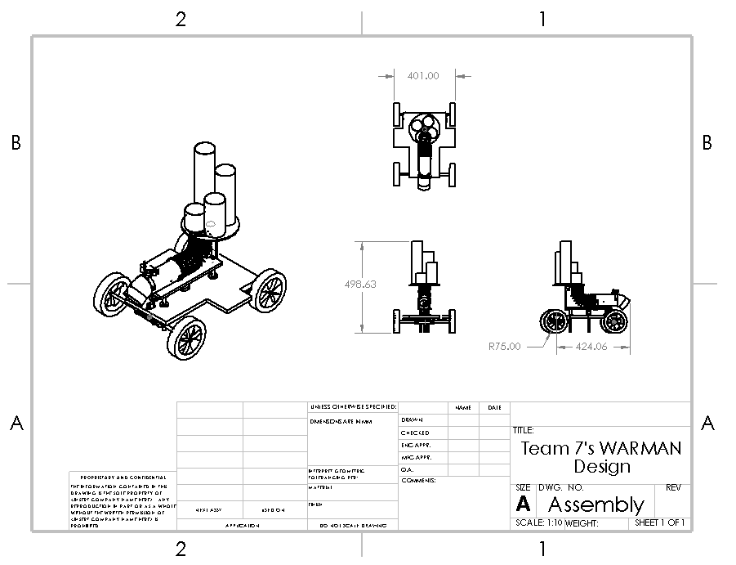
CAD Assembly
Notes:
Justin
WE designed this device to achieve the goal required. The overall concept of this device is to allow gravity to do its job and let the tennis ball flow down the pipe into the vessel.
We will be controlling the number of tennis ball using the encoder *here
Exploded animation and collapse of the device sent through email
Show general assembly (animations)

Slide 4
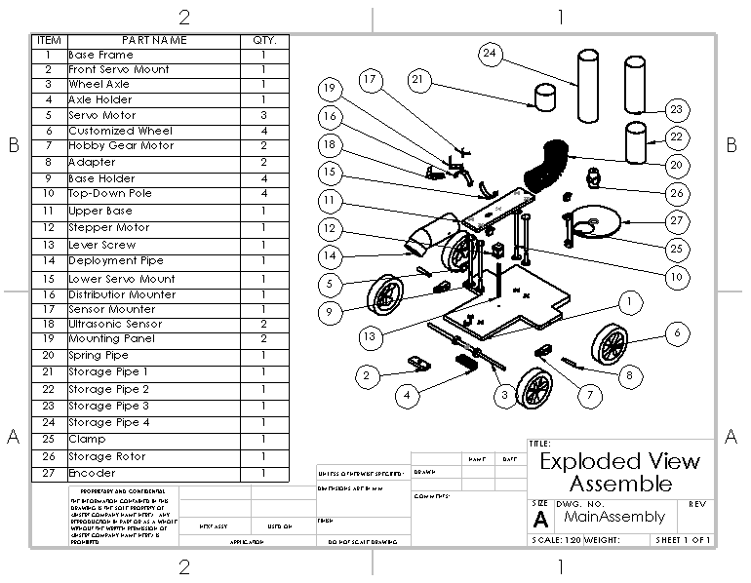
Exploded View

Slide 5
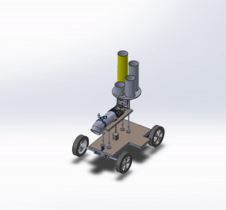
Exploded Animation of Assembly
Notes:
Justin
Exploded and collapse animation of the assembly

Slide 6
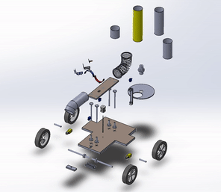
Collapsed Animation of Assembly
Notes:
Justin

Slide 7
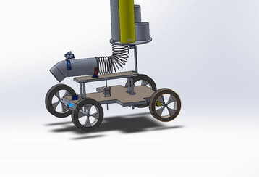
Kinematic CAD
Link to video & animation
https://unimelbcloud-my.sharepoint.com/:f:/g/personal/justinchuanw_student_unimelb_edu_au/Eo_RYJZiafFMmC76VxD6rcwBRZPLCMtflqgisliJJF4jfA?e=Ga4kIB
Notes:
Justin
Originally wanted to use Motion Study in solidworks but computer keeps crashing.

Slide 8
Subsystems
Detection System
Deployment System
Chassis & Steering
Lift System
Notes:
Justin
Briefly talk about each system.
Detection – Brain of the device. (ultrasonic sensor)
Deployment, Steering, Lift system all dependent on detection
Teammates will dwell more in-depth about each system later

Slide 9
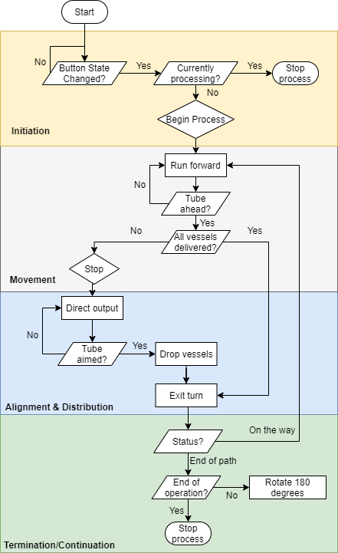
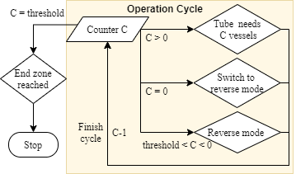
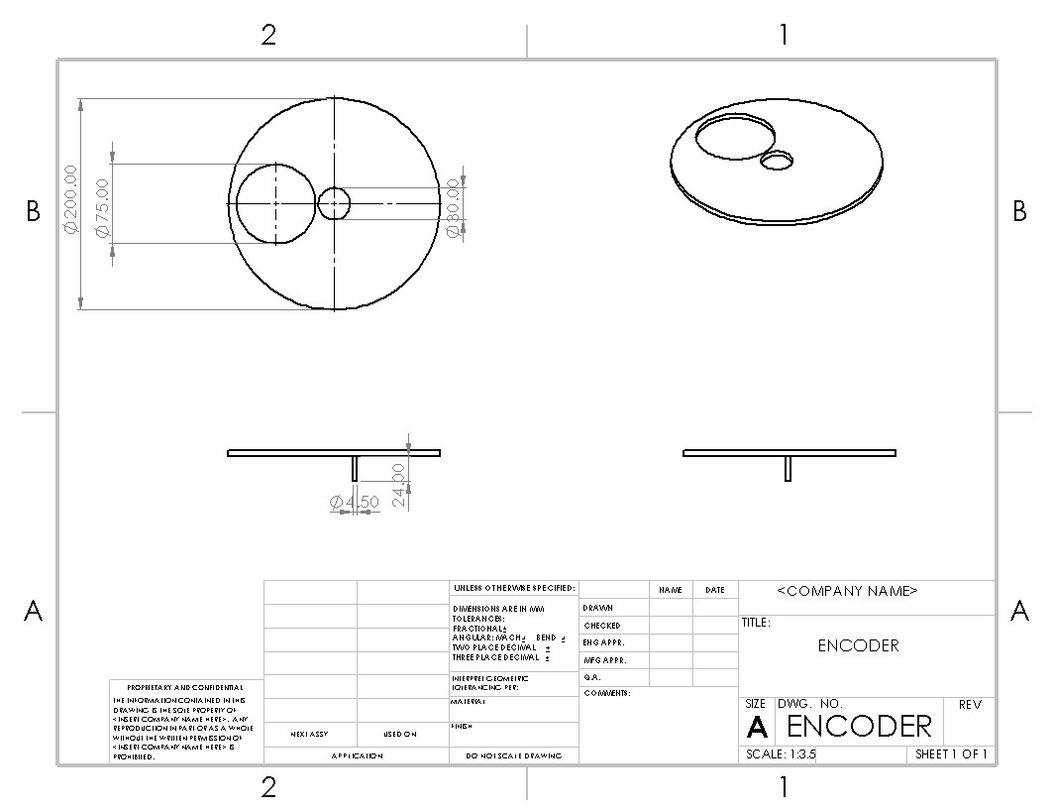
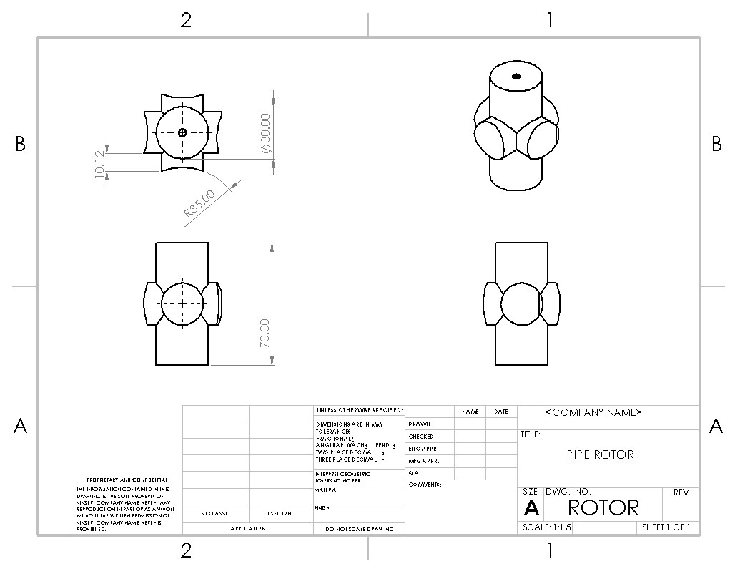
Full Logic Sequence
Notes:
The logic can be divided in to different processes:
_A button to toggle on/off state
_Move until a tube is detected
_Align deployment pipe until tube is in front, then drop vessels
_Turn until no more obstacle is detected ahead. Detection skips to this if process is finished
_When all vessels are delivered, make a 180 turn and repeat the moving process reversely
Check state with a counter:
Positive: Needs x vessels for next tube. This will control encode, which will be demonstrated further in the deployment subsection
0: just finished all tasks. Now turning to go back
Negative: Heading back to start
Threshold: Finish

Slide 10
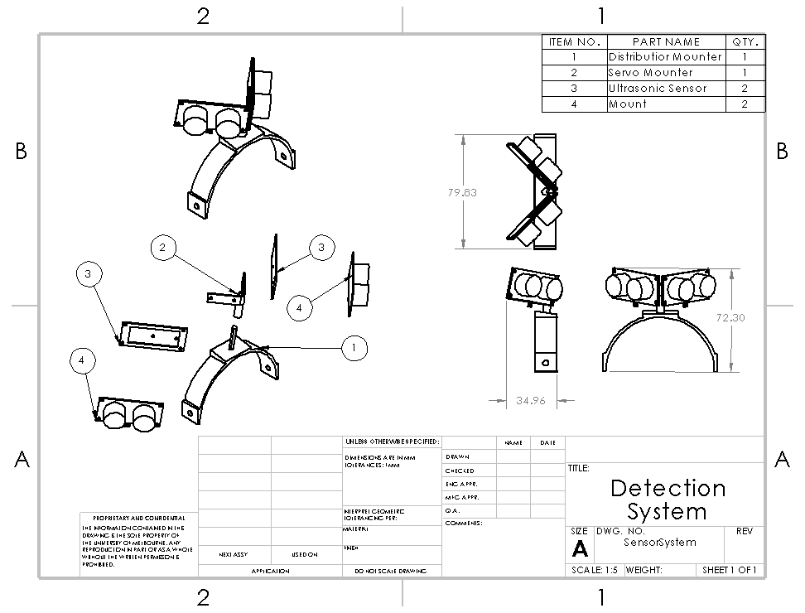
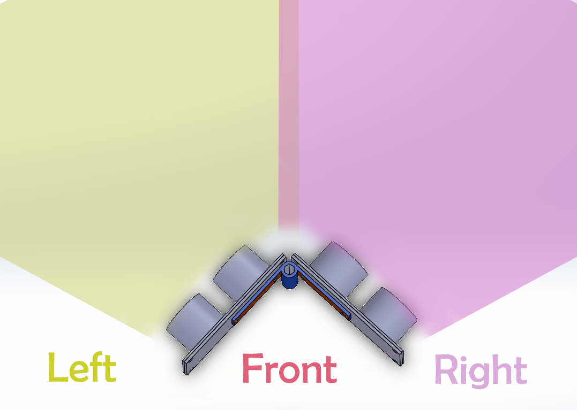
Detection System
Determines precise location to drop the payloads
Prevents device from crashing into obstacles ahead of it
Notes:
Khoi
Has the ability to detect objects to the right and left of the device
Working logic is to check for sides using 2 sensors
Will stop the motors if the object detected is less than the safety range

Slide 11
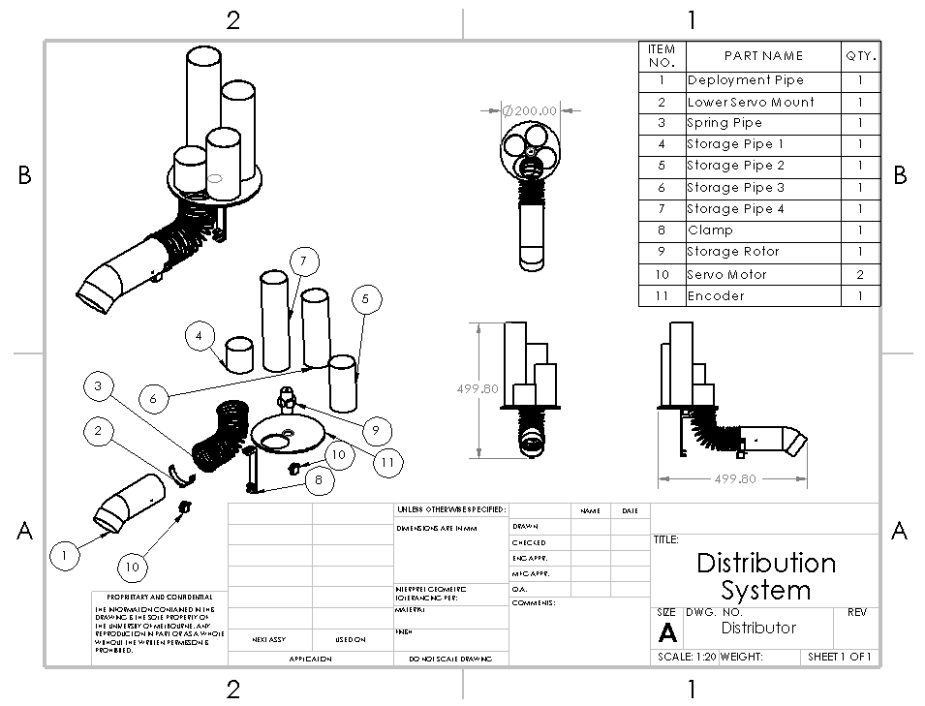
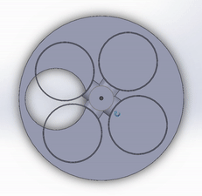
Deployment System
Enables the balls to travel from the storage tubes, through delivery tube and into vessels
Notes:
Minghao :)
-So I'll start explaining the deployment system from the deployment tube in front. -So like khoi said the device will detect the deployment point with the sensor on top of our tube. -Then the servo motor below will align the hole in front to the delivery tube/station. -Encoder will then rotate to the tube with the correct number of balls to deploy.
-The ball will the drop to the flexible tube then the momentum will carry the balls down to the hole.
Materials and why?
https://www.lazada.com.my/products/dia150mm-flexi-aluminium-hose-extend-up-to-10-ft-i364735110-s519614388.html?exlaz=d_1:mm_150050845_51350205_2010350205::12:1032211143!54400014687!!!pla-296303633664!c!296303633664!519614388!135758242&gclid=Cj0KCQjwtsv7BRCmARIsANu-CQcD-u5WC2ptfsazOeYzBCmX6zlNnklCkGswHcue81jTDY8uR2HTxJ4aAiv4EALw_wcB

Slide 12
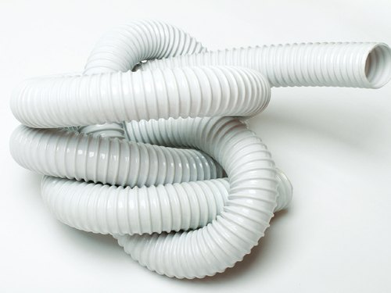
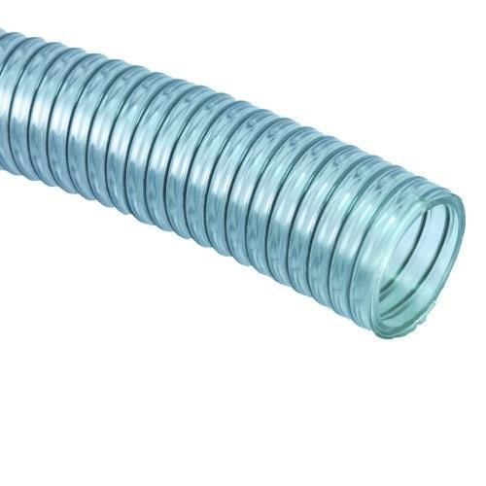
Slinky Tube
Lazada
Amazon

Slide 13
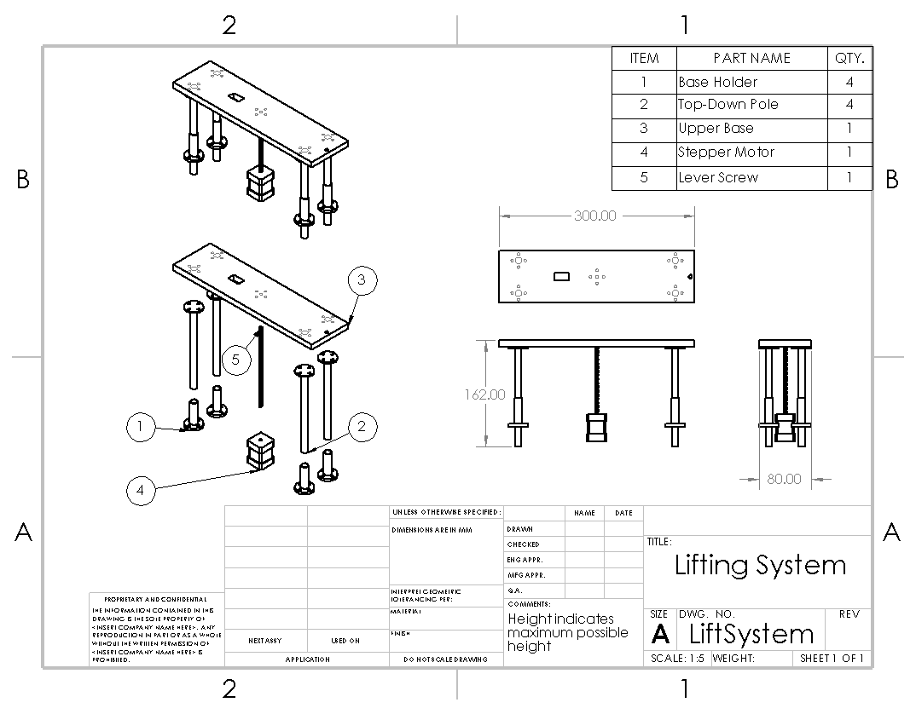
Lift System
Adjust height of platform for deployment of payload based on a specific sequence
Notes:
Justin
Depending on height of vessel. Encoded into Arduino to increase and decrease height of platform
Challenging part as the height of the mouth of deployment needs to be higher than the vessel for our concept to work, need to take into account that
Steppor motor and screw will be purchased separately. Allocated more budget to ensure lift will function
Material, Manufacture
Platform is using plywood to ensure that it can withstand load from deployment system and storage
Legs used to lift manufactured using PLA as it is a custom part, durable material as well
Hence planning to allocate more budget on the motor for lift.
Steppor motor and screw will be purchased separately.
Mainly attached using screw.
So will be easy to disassemble for testing
If steppor do fails, can swap out for another motor as legs will still be functional.
To determine best steppor for our system, need to run test. But testing of steppor will be difficult since it might be costly.
Power supply shld be sufficiently large to ensure that power allocated to steppor is sufficient for operation
(if ask will screw pierce thru, say ply wood is strong, thickness is (1cm))

Slide 14
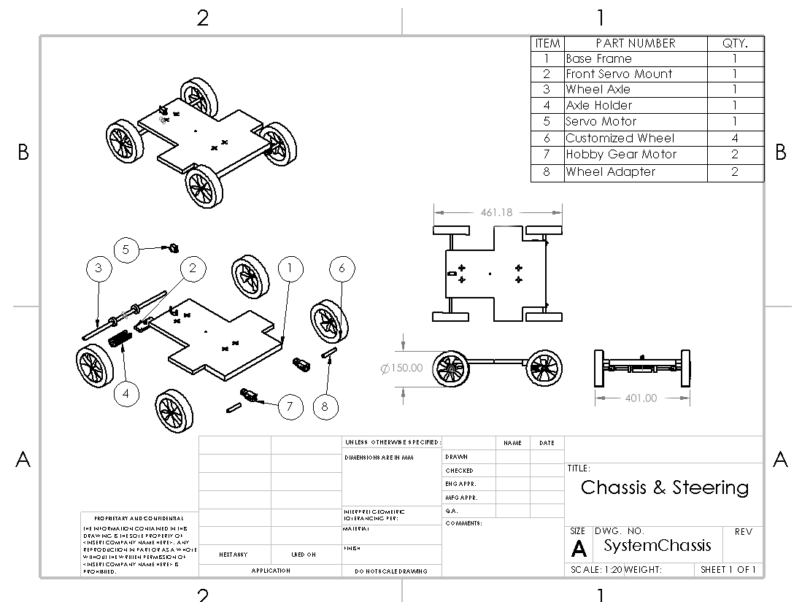
Chassis and Steering
Allows the vehicle to rotate in order to avoid collision with approaching obstacles
Enables the vehicle to direct itself towards following vessel for delivery of payload
Notes:
Nithin
- Back wheels connected to two DC motors
- Front wheels have a mount to ensure that the wheels continue to spin as the device rotates
- Size of wheels slightly larger than usual to hope that it can pass over the boundary (this might give an edge as we chose to go over it instead of around it, giving us higher score on the runtime)
- Axle mount made from PLA, axle itself is a steel rod, wheels are rubber with plastic rims
- Adapter (8) to ensure the motor can be connected directly to the wheel
- Chassis made from plywood
- Cut formed to ensure that the rotation of the wheels will not hit against the chassis
Connection
- The axle will be an accurate size to ensure that it is a snug fit into the wheel
- The mount will be stuck on using double sided tape or a strong glue
- DC motor will be connected to the chassis using either double sided tape, glue or screws depending on available resources

Slide 15
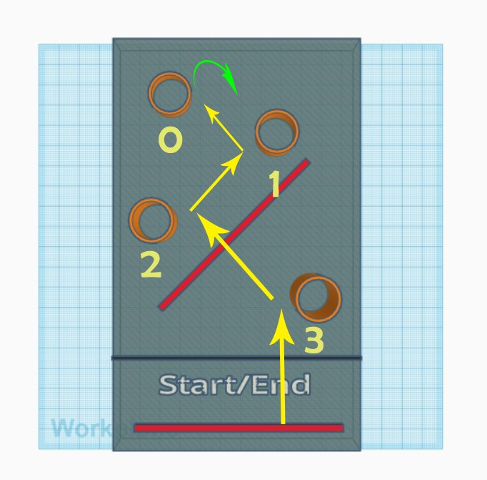
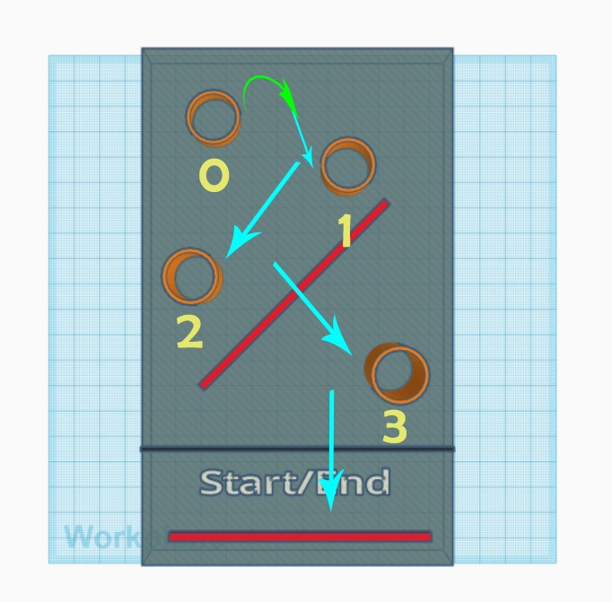
Device pathway
-
- Movement of the device as it drops payloads and returns to start/end zone
- Numbers indicate the next number of payloads to be delivered to following vessel
Notes:
Nithin
- Detects object in front stops then rotates ass mentioned by Khoi
- after delivery will move to next vessel
- Once all balls delivered, device will make a 360 degree turn and return back to start/end zone with the same route
- Without actually delivering the ball
(Khoi's suggestion) Explain that this head start will help the device approach the obstacle prependicularly, and hence minimize pivoting torque
- Might be slower than other methods but will ensure accuracy of deployment

Slide 16
Why this solution?
This year's question combines challenges!
Priority: Simplicity & Versatility
Simplicity of assembling.
Components are easy to manufacture (simple shape) or bought (common materials).
The prependicular approach to the obstacle.
Trade-off between accuracy (can be improved) and efficiency.
Notes:
Khoi
Explain why this solution is better the the rest
There are 3 types of deployment:
-Grappling hand
-Drop and dodge (our choice)
-Direct drop
2 types of coming to the obstacle:
_Avoid
_Approach (our choice)
Explain with pros and cons:
_This year is mixed challenges, and we favor simplicity
_Components are easy to assemble together
_Custom components are easy to make, common components are easy to find
_This design incorporates the prependicular stepping over the obstacle, cutting down the cost of avoiding it
_This design need further trials for high accuracy since it consists of many degree-of-freedom that can affect the whole process (turn angle, sensor range). However, this can be impoved, and when put with the efficiency that it brings -> big brain

Slide 17
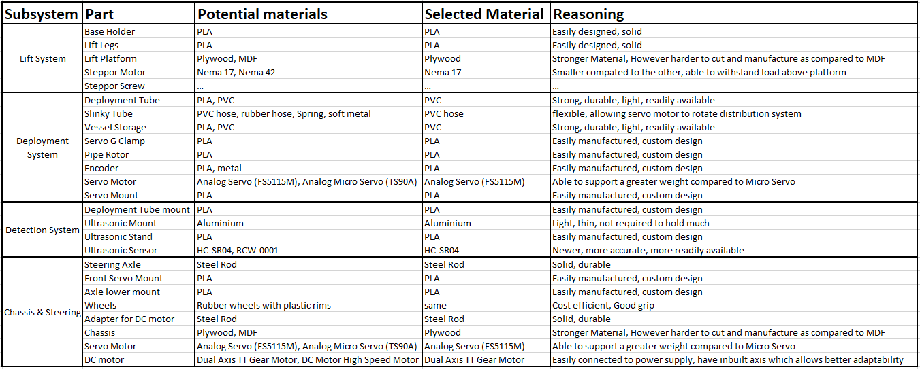
Materials
Notes:
Justin

Slide 18
Problems Faced
Working remotely due to COVID.
Groupmates currently in different country. (Time Difference)
Not able to run tests on our device.
Need to rely mainly on assumptions while designing our device.
Lack of computational power while operating SOLIDWORKS.
Not having enough experience operating CAD software.
Notes:
Improvements:
Develop more efficient method to overcome obstacle
Delivery & storage
Accuracy for delivery
Lift system, change different type
Challenges faced while working on the device:
Different compared to last years competition
Combining different types of challenges into one

Slide 19
Most likely catastrophic failure
Device does not have enough power to cross over obstacle on course. (Divider)
Wheel Axle snapping from overturning.
Device topples backward due to imbalanced weight distribution.
Payload stuck in slinky tube.
Faulty sensory might make the device go off the map
Make wheels larger for better thrusting (similar of monster truck).
Limit the angle of turn through trials
Adjust the deployment system towards center.
Minimize the length, favor vertical positions.
Set a reverse mechanism, adjusting the angle between 2 sensors.
Notes:
Ming Hao :)
-Which is why we made the wheels larger, allowing it to just go over the obstacle (like monster truck)
-If wheels axis turns too much, it will crash into the chassis and most likely will snap due to the force.
-Storage of tennis ball might cause device to topple over
-Weight when balls drops might cause it to be stuck at the base of the flexible PVC part of our device.

Slide 20
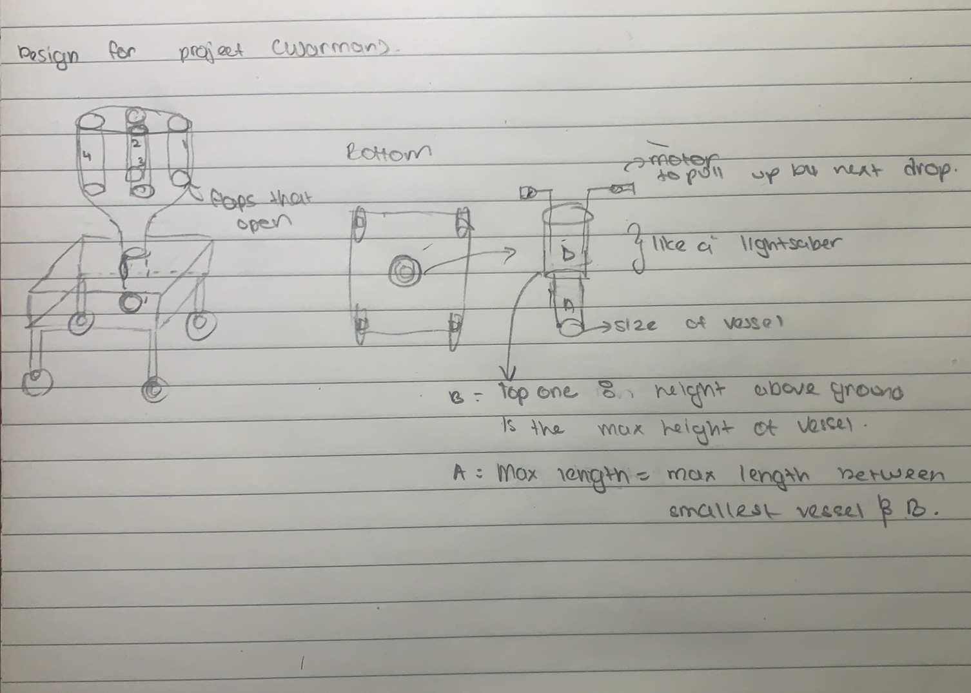
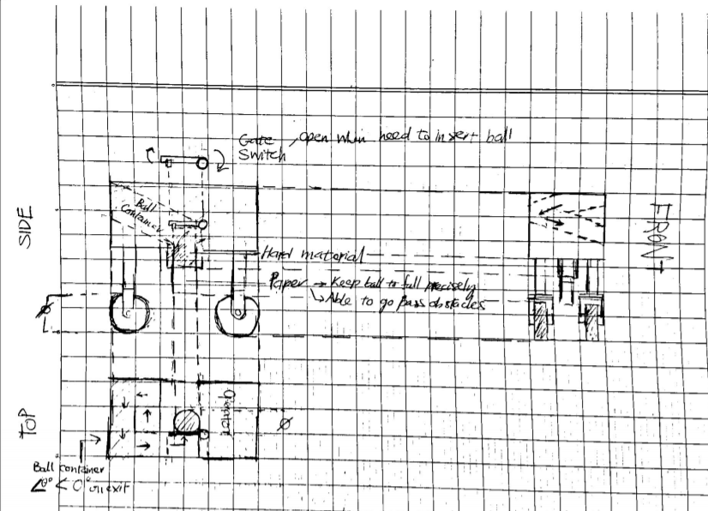
Past Ideas & Potential Improvement
Sensor System to measure the tube height as well
Pipe sections with rotational joints instead of slinky
In-place dropping (Sink design)
Notes:
What ideas have or can be implemented? (I suggest Nithin go for this – Khoi)

Slide 21
THANK YOU
TEAM 7
Justin Chuan Wai Lee
Ming Hao Yong
Nithin Daniel Sundram
Tuan Khoi Nguyen
Notes:
Say a thank you

